Slide 1
ZenFox
CS544 2009F Project Phase III
The Tab Four
Lam, Billy
MacKenzie, Russ
R, Mohan
Su, Tao

Slide 2
Agenda
Problem
Redesign
Implementation
Evaluation Procedure
Results
Demo + Video

Slide 3
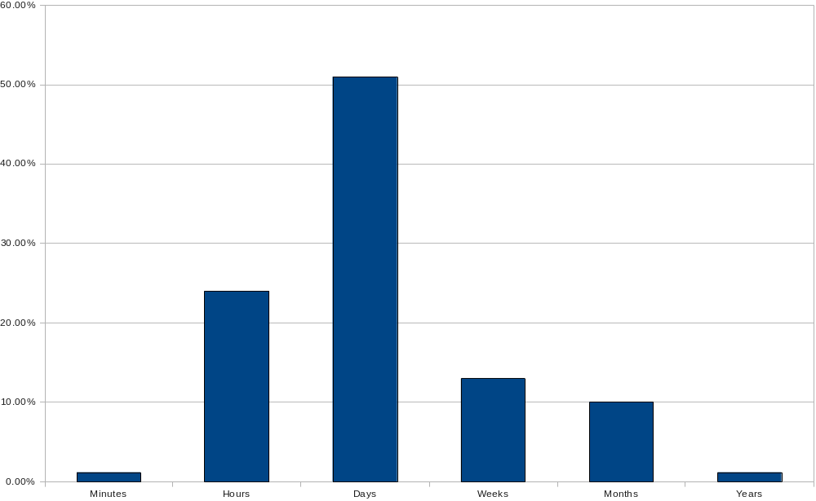
Problem
Support for multi-session tasks
Percentage of users
Time before task resumption (Survey from SearchBar: Morris et al, 2008)

Slide 4
Problem
Strategy | Respondents
Active Storage / Active Retrieval | 55.00%
Written or typed notes | 30.00%
Browser bookmarks | 26.00%
Save Web pages locally as files | 5.30%
E-mail to self | 2.40%
Online bookmarks/tagging | 1.80%
Print Web pages | 0.60%
Passive Storage / Active Retrieval | 8.20%
Browser history | 7.60%
Online query history | 1.20%
Passive Storage / Passive Retrieval | 49.00%
Memory | 36.00%
Leave browser open | 14.00%
Link coloring | 2.40%
Autocomplete | 2.40%
Current coping strategies for task resumption (Survey from SearchBar: Morris et al, 2008)

Slide 5
Problem
Strategy | Respondents
Active Storage / Active Retrieval | 55.00%
Written or typed notes | 30.00%
Browser bookmarks | 26.00%
Save Web pages locally as files | 5.30%
E-mail to self | 2.40%
Online bookmarks/tagging | 1.80%
Print Web pages | 0.60%
Passive Storage / Active Retrieval | 8.20%
Browser history | 7.60%
Online query history | 1.20%
Passive Storage / Passive Retrieval | 49.00%
Memory | 36.00%
Leave browser open | 14.00%
Link coloring | 2.40%
Autocomplete | 2.40%
Current coping strategies for task resumption (Survey from SearchBar: Morris et al, 2008)

Slide 6
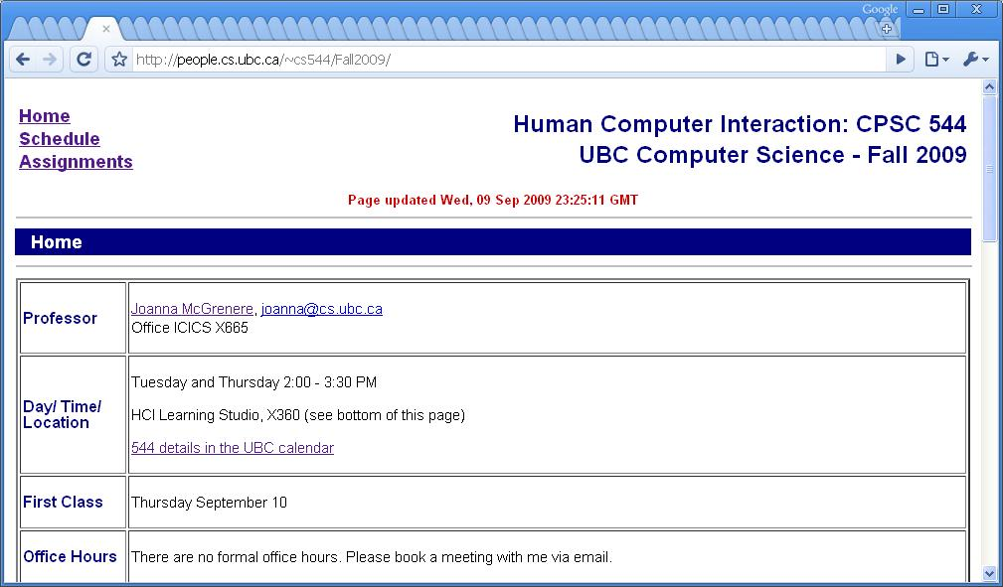
Problem
Information overload

Slide 7
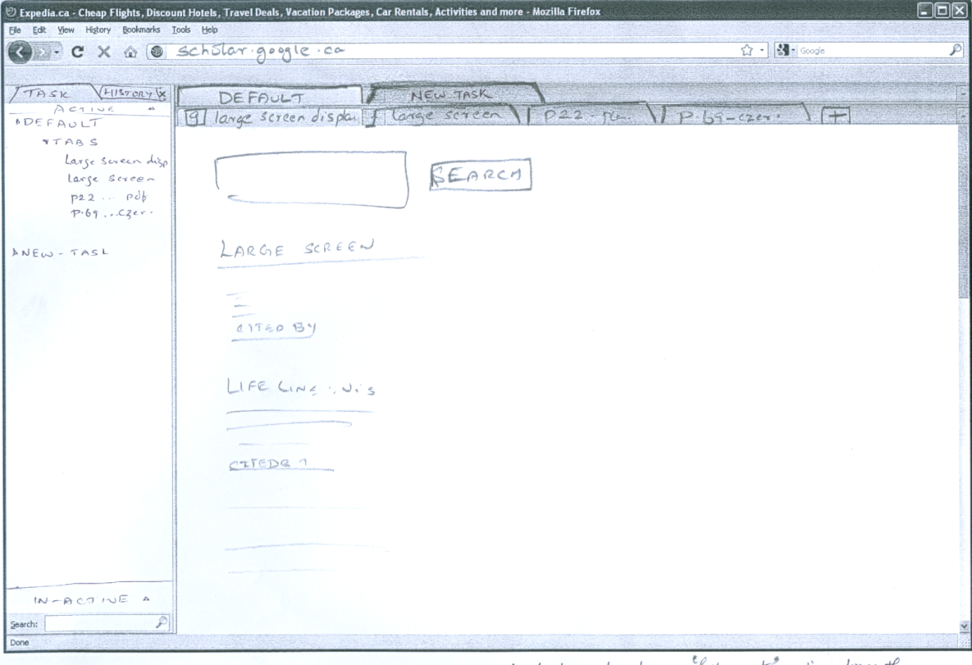

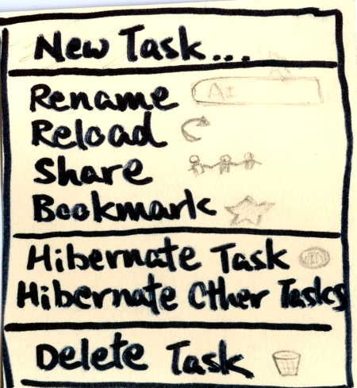
Redesign
Review: A task-focused browser interface
  Suspension and Interruption
  Annotation
  Sharing

Slide 8
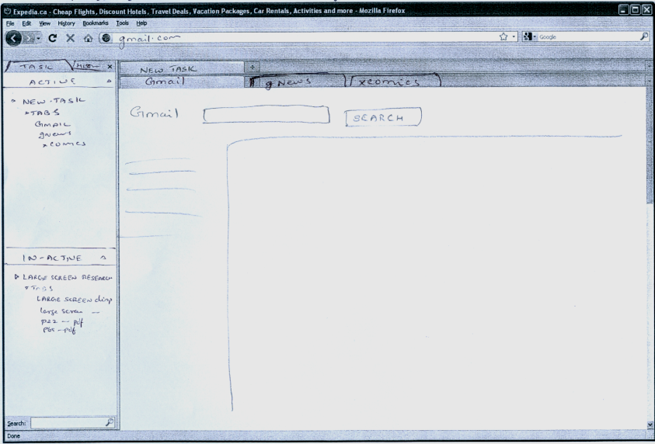
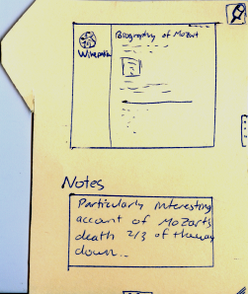
Redesign
Lessons from Phase II
  Paper prototype generally well-received
    Excitement about ideas
    Generally kept all features
    Two key points
    . Transparent sharing
    . Default hiding of task management features

Slide 9
Redesign
Worries about sharing feature
  But still keen on easier sharing
  Originally just attach/send files
    What if there’s an error? What if they can’t open it?
    What if versions change?
  Software isn’t even written and already they don’t trust it!
Replaced drag-n-drop and added cloud sharing

Slide 10
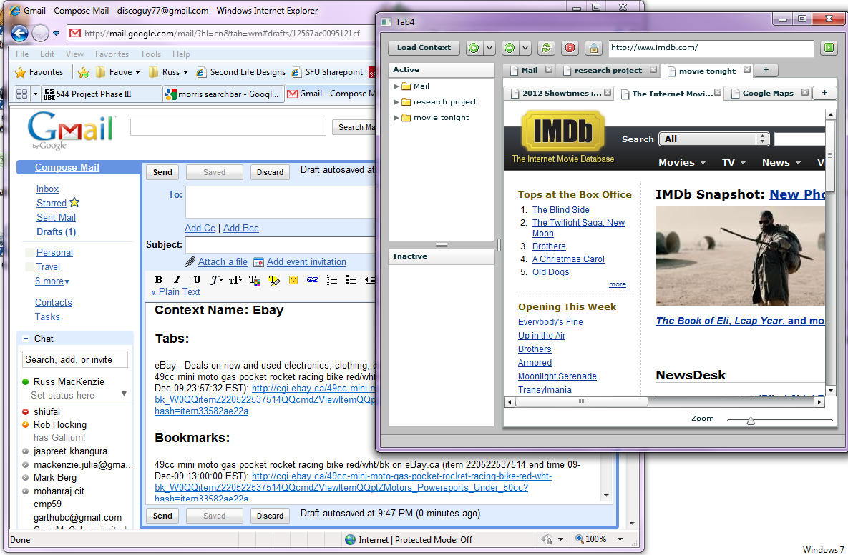
Redesign
Drag
&
Drop

Slide 11
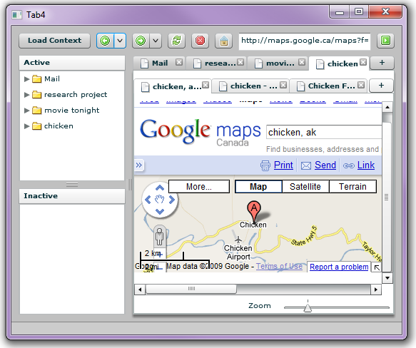
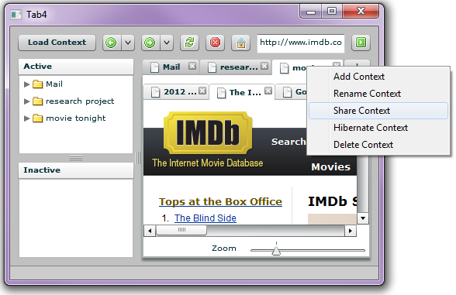
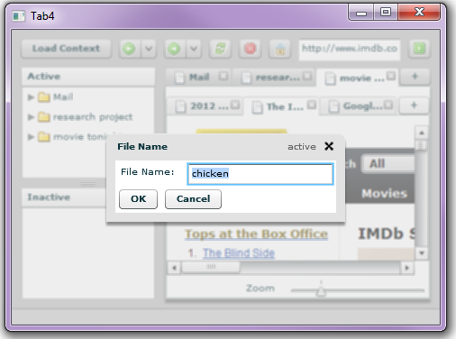
Redesign
“The internet”
Drag
&
Drop
Share
Load
Entire context is loaded!

Slide 12
Redesign
“The internet”
Drag
&
Drop
Share
Load
Entire context is loaded!

Slide 13
Redesign
“The internet”
Drag
&
Drop
Share
Load
Entire context is loaded!

Slide 14
Redesign
“The internet”
Drag
&
Drop
Share
Load
Entire context is loaded!

Slide 15
Implementation
Firefox plugin vs Flex prototype
  Practical significance vs. practicality for CS544
Subset of features: vertical prototype
  Annotation
  Suspension and Resumption
  Sharing

Slide 16
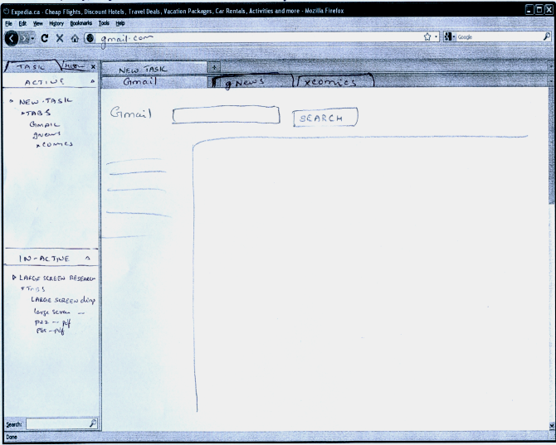
Implementation

Slide 17
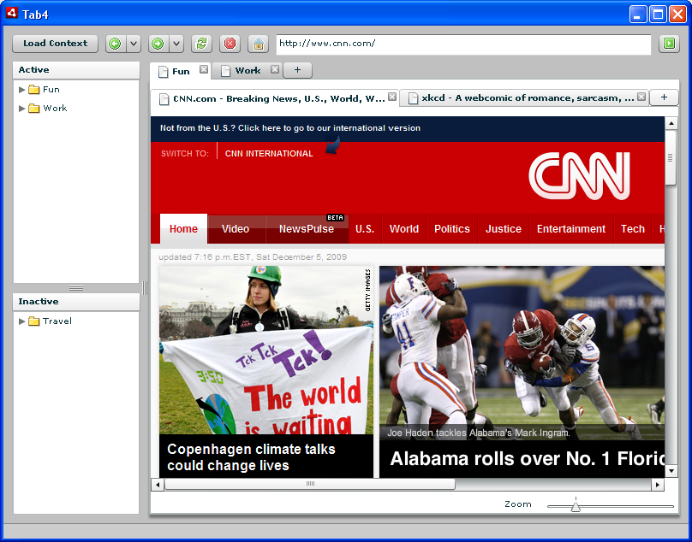
Implementation

Slide 18
Evaluation Procedure
Extended use of prototype not feasible
8 subjects, comparison with FireFox
  Very minimal training session
Short (& intensive!) multi-tasking scenarios
  Interruption
  Suspension
  Resumption
  Sharing

Slide 19
Evaluation Procedure
Primary Task
  Trip planning with hypothetical friend
    “Mark” or “Jane” – same sex as subject
Communications through Email and IM
Interrupts through IM
  Add secondary tasks
    Extra details to primary task (sightseeing)
    Interruption of primary task (research papers)

Slide 20
Evaluation Procedure
Questionnaires and short discussion
  Work load of assigned tasks
    Immediately after trial
    7 point Likert scale
  Comparisons between browsers and general questions
    At end of session

Slide 21
Results
Quantitative analysis of data
NASA TLX-like
  Used Wilcoxon test, Bonferroni corrected
  All task load questions non-significant, p > 0.1
  Still, 6/8 rank TabFour higher for question:
  “How effectively did the browser interface
  support what you were asked to do”?

Slide 22
Results
Quantitative analysis of data
Other questions mostly unanimous:
  Which browser was easier to use to complete the tasks? -TabFour
  Did you find the task-based browsing useful? –Yes
  Would you use task-based browsing if it was available in your regular web browser? –Yes
  In which browser was it easier to share webpages with other people?
  -TabFour

Slide 23
Results
Qualitative feedback
  Usability issue on Load/Share context dialog
  More organized in TabFour
  Integration with existing tools desirable
    Want to click links/task names in email
  What if Mark gives me a bad link (typo)?
  “Simple, doesn’t require extra learning to use”

Slide 24
Results
Qualitative feedback
  “FireFox lets you see things all at once”
  Benefits and costs more obvious in prolonged use?
  “Task groups cut down on time needed to complete tasks”

Slide 25

Demo + Video

Slide 26
Questions?

